Slide 1
CAIQUE RIBEIRO SILVA STUDENT ID - 20241524 SOFT807 Cloud Application Development

Slide 2


Cloud Computing My Starting Point
First contact with Cloud Technology in 2014
User Support Role for UOL provided by Teleperformance

Slide 3


Cloud Computing Services - 2024
Platforms

Slide 4

Honourable mention

Slide 5
The first challenge: Cloud Terminologies
Deployment
Containers
Virtual Networking
Pricing
Elasticity
Paas
Iaas

Slide 6
Diving in the Cloud Virtual World
The first step to understanding a subject is to understand it’s language.
Write down your notes! E.g., Word, Notepad
Navigate through forums to familiarise yourself with terminologies and where to use them. E.g., Microsoft Learn, Google Scholar, Stack Overflow FAQ’s

Slide 7
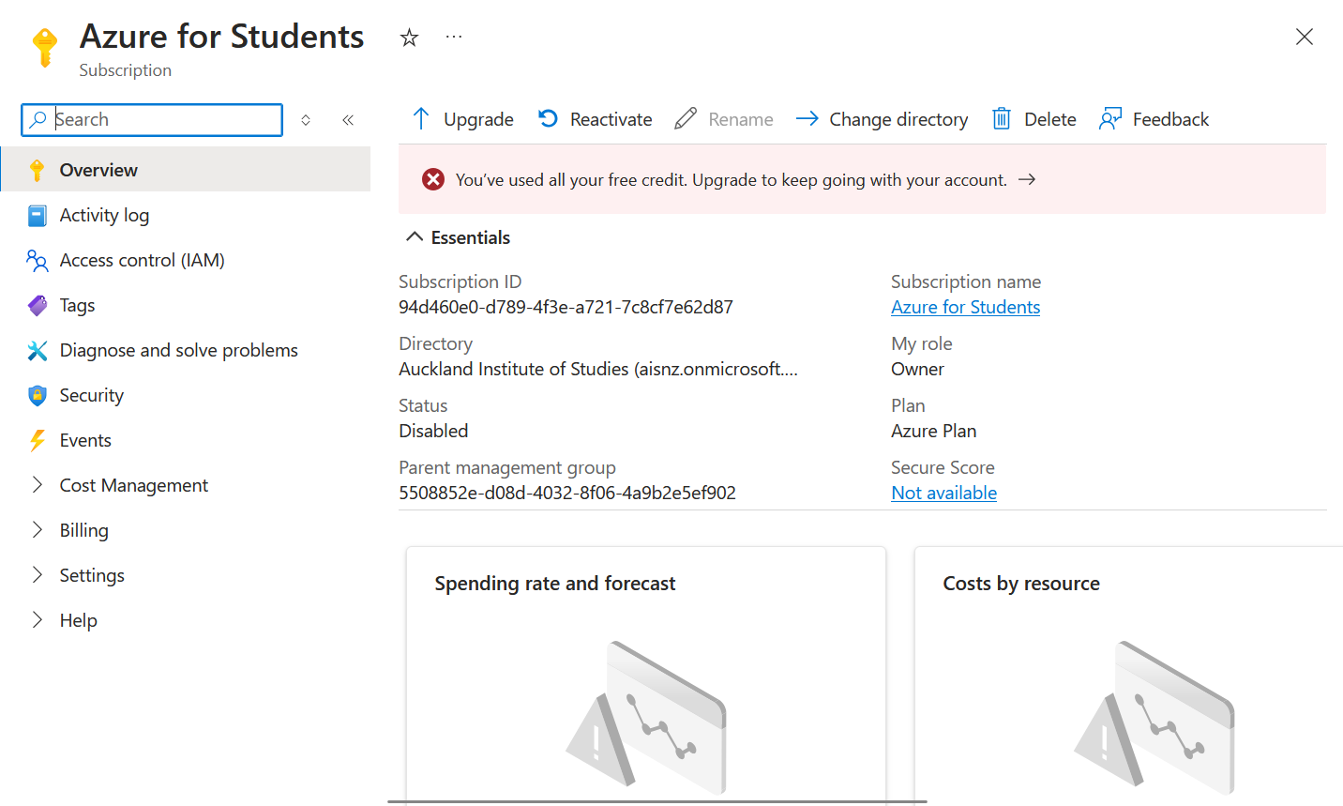
A Lesson to Learn - Pricing
A quiet and ruthless monster

Slide 8
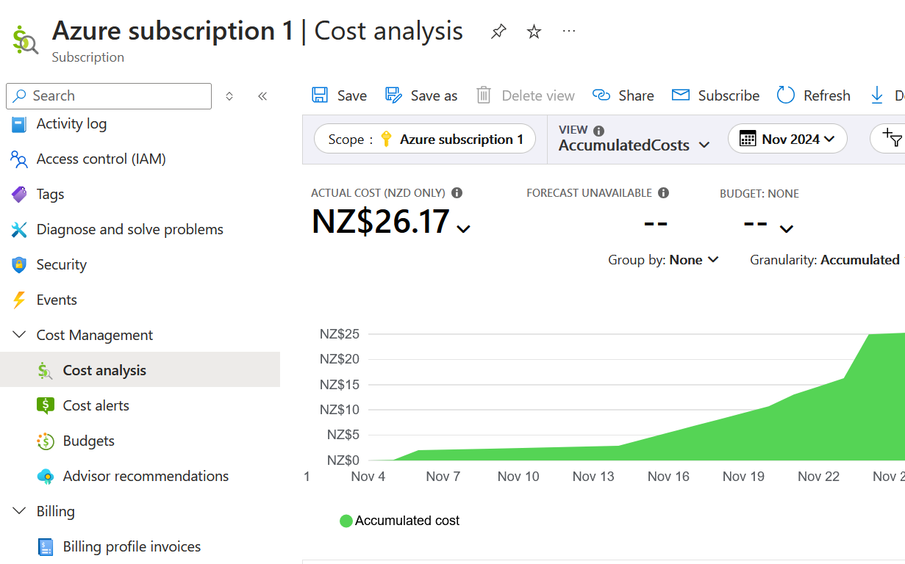
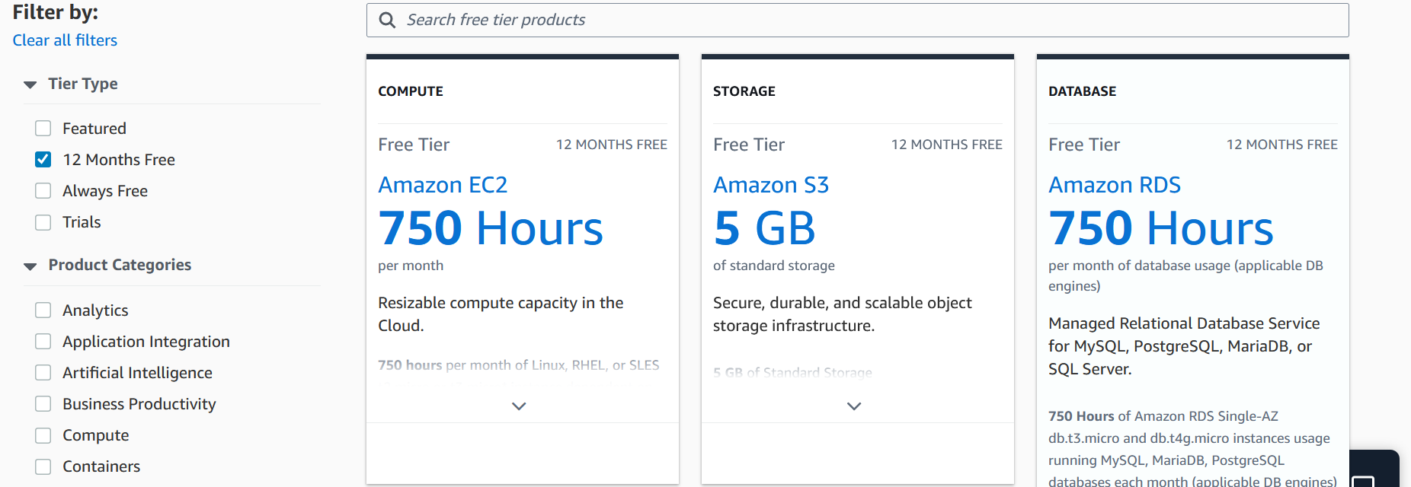
Lesson Learned
Microsoft Azure
Amazon Web Services
Retrieved from: https://portal.azure.com/
Retrieved from: https://aws.amazon.com/free/

Slide 9
Resource Groups and Bucket - Containers
One thing leads to another…
from depleted student credits
to understanding how to manage active resources
Resource Groups – Microsoft Azure
Bucket – Amazon Web Service

Slide 10
Resource Groups and Bucket - Containers
After going through a few problems with Cloud credits, I understood that containers are a pivotal part of Cloud Services.
They store and virtualise software packages that speed up configurations and, on top of that, are made to be run in any environment.
Understanding this core concept allowed me to group configurations and services in one place, making controlling costs and managing active services in my account easier.

Slide 11

The final challenge
VPN Gateway
Virtual Network
Load Balancer
Transferring protocols

Slide 12

Learn with your own process
Identify what needs to be learned
Associate the knowledge
to the tools/service
Understand terminologies
Explore the tool/service

Slide 13
Conclusion
Cloud computing has vast functionality and benefits for the technological universe. Creating assignments using real-world examples was crucial for my understanding of this complex service that, with no doubt, will extend to other areas of I.T.
Therefore, I appreciate the journey, and I feel ready to take a step forward into the corporation environment with new challenges, workmates and exploring new technologies.

Slide 14
Thank you

